Slide 1
CLS Foundation
Registered: 371/2006
Income Tax Approval : DIT(E)/HYD/12A & 80G/
79(12)/06-07
Hyderabad, India

Slide 2
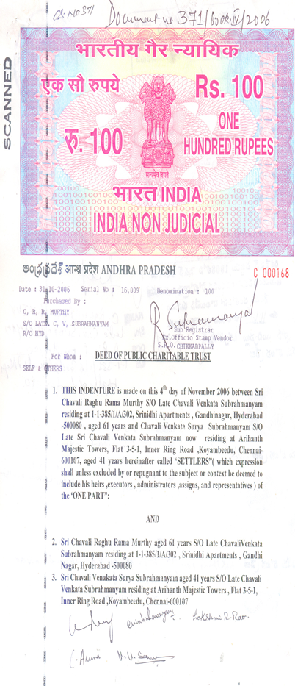
Background
CLS Foundation was started on 4th November, 2006 at Hyderabad. Incorporated as a registered public charitable trust under public charitable trust act with the initiative of few socially conscious people with an intention to extend a helping hand to the needy. The trust was started in memory of Late Shri Chavali Venkata Subrahmanyam and Late Smt. Chavali Lakshmi Narasamma, who have themselves rendered self less service to many during their life time.
Commitment on annual contribution to the trust is made by the founders to begin the activities of the trust. All the founders are committed to give their annual contribution as long as the trust exists. Over the years the activities of the trust have grown with the commitment of trustees and contribution from many donors who have extended their helping hand after learning about the services of CLS Foundation. Beginning with just 7 donors and 20 beneficiaries in 2006 the activities have grown to 46 donors and 451 beneficiaries in 2018.

Slide 3
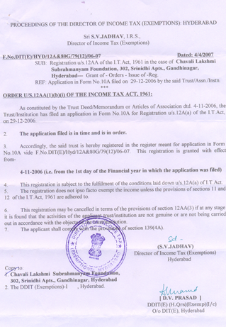
Formative Years
The untiring efforts of Mr. C.R.R. Murthy, the founder Chairman of the trust and supported by the Life Trustees have brought smiles to many in need of help. CLS Foundation has crossed many milestones and the number of beneficiaries from the activities of the trust have grown month after month.
We have been recognized for our efforts and were awarded income tax exemption under section 80G. All donation to CLS Foundation get income tax exemption under section 80G.
The mission of trustees is to identify and encourage people to give back to the society and experience the JOY of giving. CLS Foundation is acting as bridge in bringing together people in need of help and the people who can help.

Slide 4
About Trustees
Mr. C.R.R. Murthy and Mrs. C. Prabhavathi (Hyderabad) - Mr. C.R.R.Murthy is retired from Hindustan Aeronautics as AGM. He has worked in other reputed organisations like Praga Tools and Tata Motors in senior positions. He is M.Tech from IIT, Kharagpur.
Mr. C.V.S. Subrahmanyam and Mrs. C. Kanaka Durga (Chennai) – Mr. C.V.S. Subrahmanyam did his B.Tech, Chemical Engineering from Osmania University and PGDM from XLRI, Jamshedpur. He is now working as Regional Business Head in Inox Air Products Pvt. Ltd and prior to this has worked in reputed companies like Siegwerk, Nerolac Paints, Funskool and Jenson and Nicholson in senior positions.
Mr. M. R. Rao and Mrs Lakshmi R Rao (Hyderabad) – Mr. M.R. Rao is B.Com, CAIIB and is retired as Senior Manager from Bank of Baroda. He has been consultant to many reputed business firms.
Mr. Vemuri Venkateswara Sarma (Rajahmundry) – Mr. V. V. Sarma is an agriculturist and has been actively involved in many social activities right from his younger age.
Mr. Eranki Kamesh, M.Sc, M.S and Mrs E. Nagamani, M.Sc (residents of USA) – Mr. Kamesh has worked earlier in Oracle and he has now started his own Company in USA.
Mr. Khambampati Prasad, P.hd in Pharma and Mrs. K. Padmaja, M.S (residents of USA) – Both are working for reputed companies in USA
Mr. Garimella Sesha Kumar, P.hd in Chemistry and Mrs. Aruna M.C.A (residents of USA) - Mr. Sesha Kumar is working in Dr. Reddy Labs at USA in the senior management position and Mrs. Aruna has worked in Accenture and is now on her own.

Slide 5
Mission
CLS Foundation is an organization of trustees and members who actively engage themselves and continuously explore all possible avenues to help the needy. Act as a bridge between the people who need help and the people who can help. We spread the message and impress upon people on
JOY of GIVING.

Slide 6
Vision
We actively work in identifying and enrolling socially conscious donors who can help the needy. We explore all possible opportunities of extending help when we come across the people who need a helping hand to make their lives better. We tirelessly work to achieve the objectives for which CLS Foundation was started.

Slide 7
Objectives
To provide financial assistance to meritorious under privileged children to help them complete their education without any discrimination on account of caste, creed, religion and sex.
To grant aid in cash or kind for undergoing medical treatment or surgery for deserving patients to meet the cost either fully or partially.
To establish, promote, setup, run, maintain, assist, finance support, and/or aid orphanages, old age homes etc., to help the poor, old and infirm people without any discrimination as to caste, religion or sex.
To grant, aid or render assistance to other charitable trusts or institutions.
To print and publishing books, pamphlets, periodicals in India for the spread and advancement of education and culture.

Slide 8
Merit Scholarship for Education
Class : Xth
Scored: 97%
Year : 2006-07
Sponsored Amount : Rs 3000/- per annum
Institution : Sri Satya Sai Vidya Vihar High School, Hyderabad
Parent’s Income : Rs 24,000/- per annum
For Future - ‘Extended commitment’ to take care of his future Education needs (want’s to be a Engineer)

Slide 9
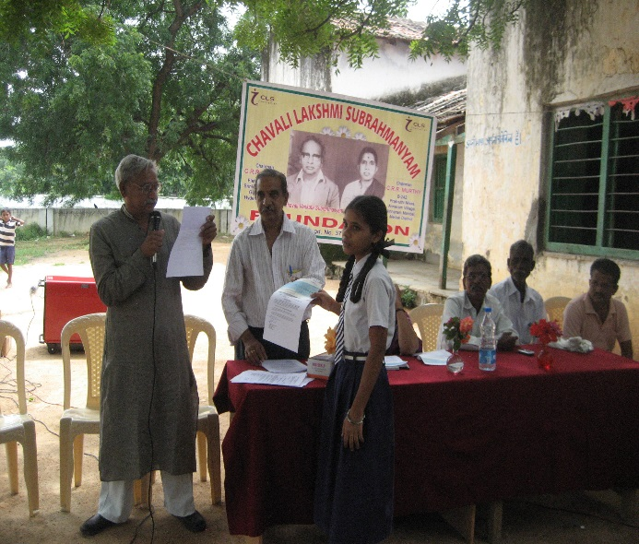
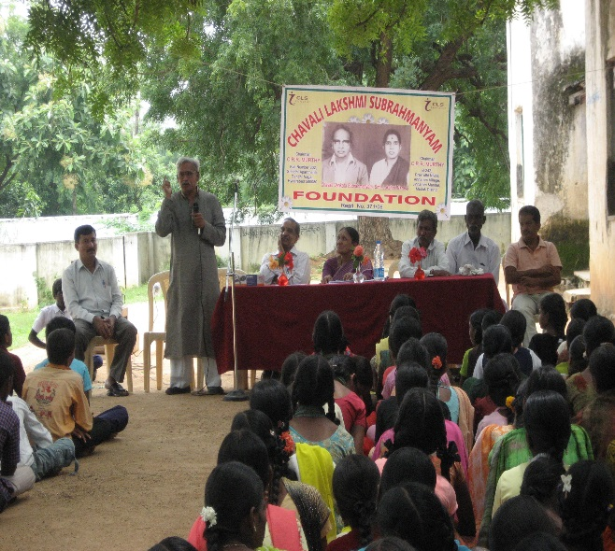
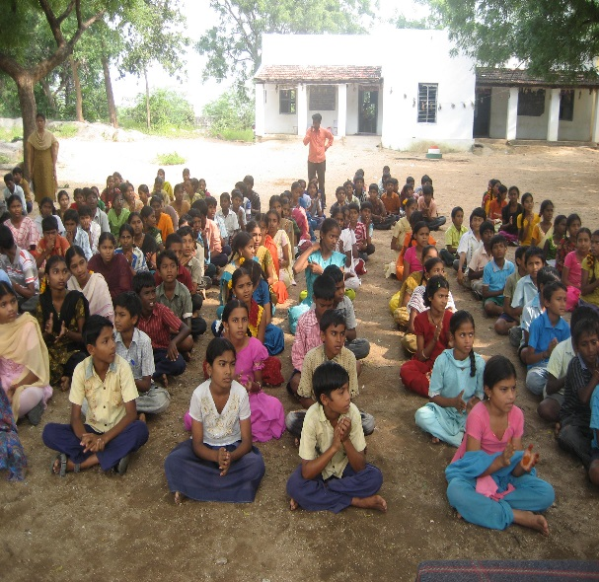
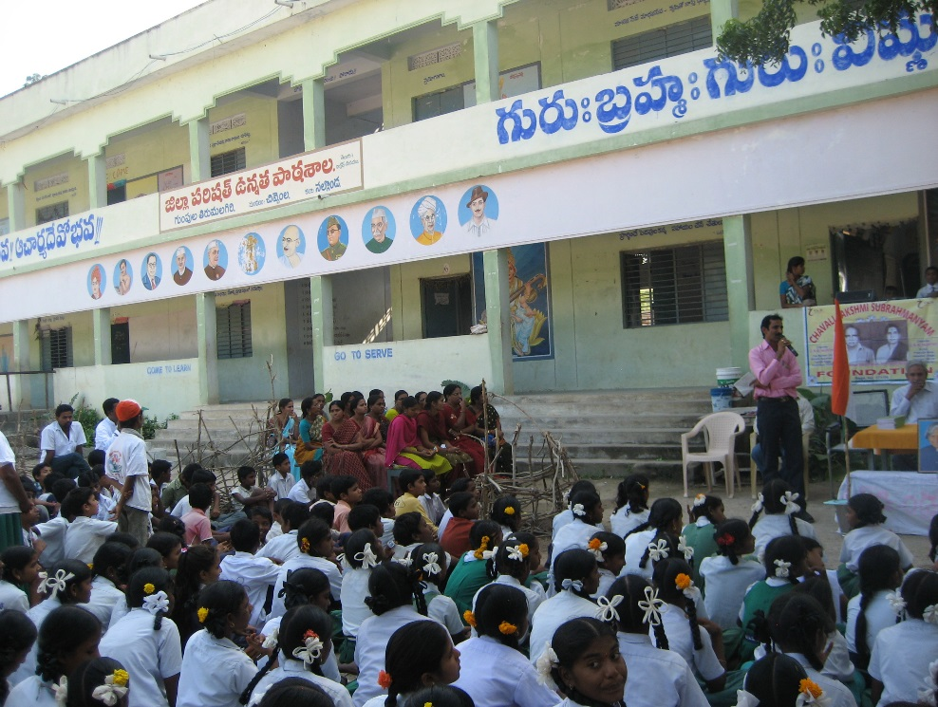
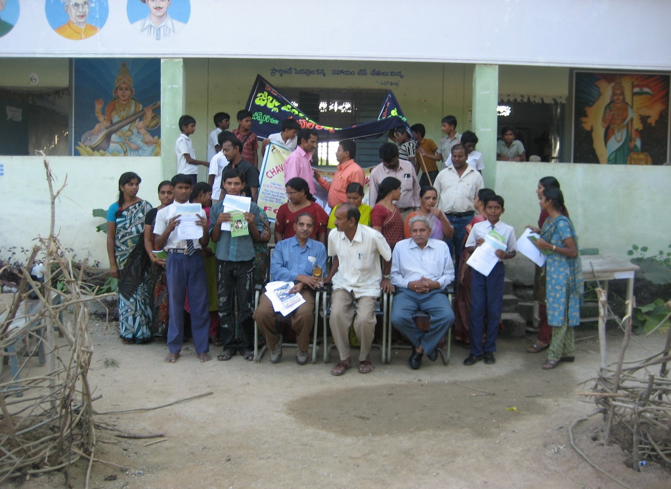
Photo gallery
Meritorious student collecting scholorship
Life trustee of CLS foundation addresing students
Students
Chief guest speaking to students
Trustees with all students who have collected scholorships

Slide 16
Contact for donations (Donations are exempt from income tax under section 80G)
Executive Trustee
CLS Foundation
B-242, Prakruti Nivas.
Annaram, Jinnaram Mandal,
Medak - 582 302
Mobile: +91-9966014241
+91-9841044363
Email: crrmurthy@gmail.com
chavali65@hotmail.com

